Slide 1
As…as…

Slide 2
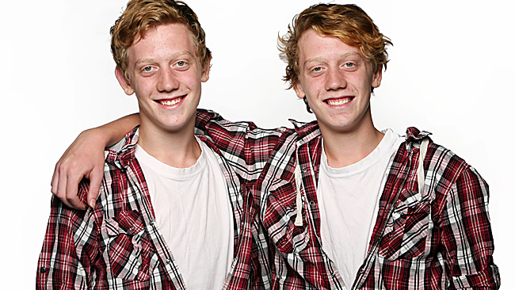
James is as tall as Moses.
Be + as + adjective + as
James´s hair is not as long as Moses´s.
Be not + as + adjective + as

Slide 3
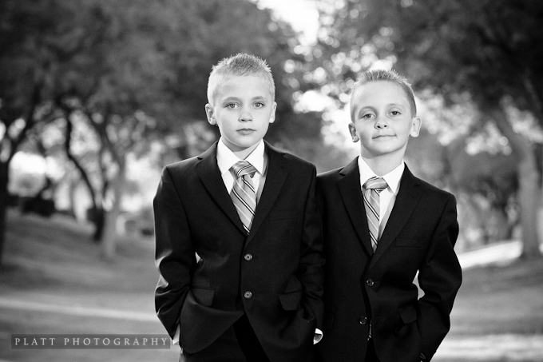
Reza studies as hard as Farid.
Verb + as + adverb + as
Reza does not smile as much as Farid.
Do/does not Verb+ as + adverb + as

Slide 4
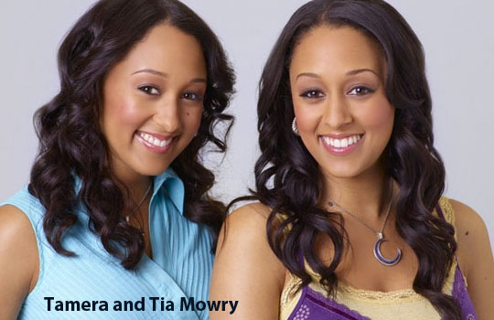
Tamera is as happy as Tia.
Be + as + adjective + as

Slide 5

Ed has not worked as long as Ted.
Do/does not Verb+ as + adverb + as

Slide 7
Dan's house
Tom's house

Slide 8

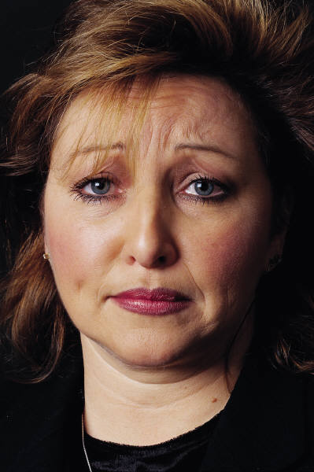
Jan
Julie

